Slide 1
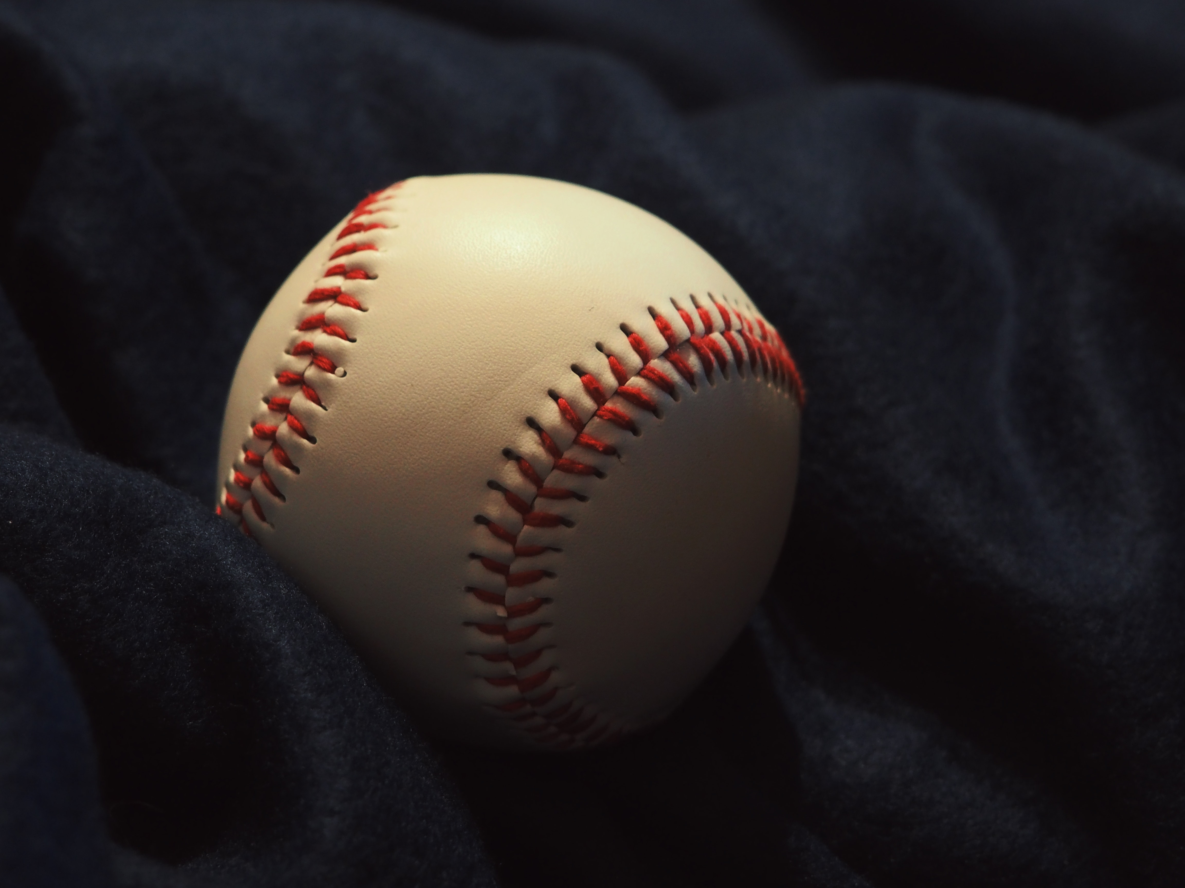
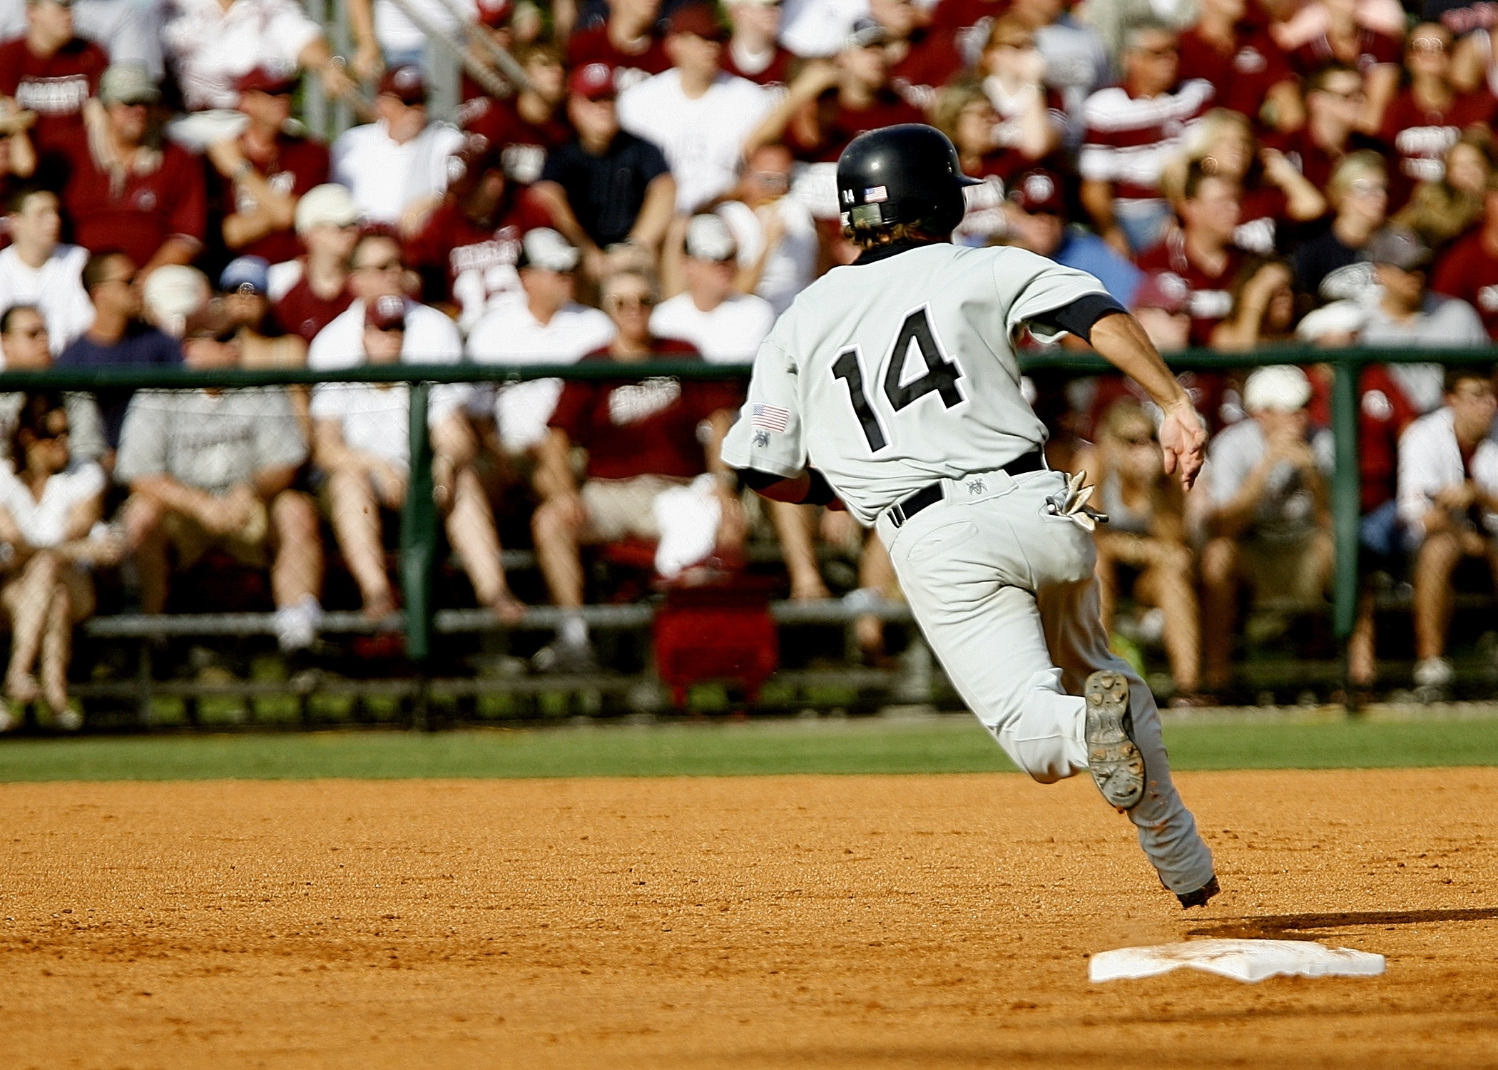
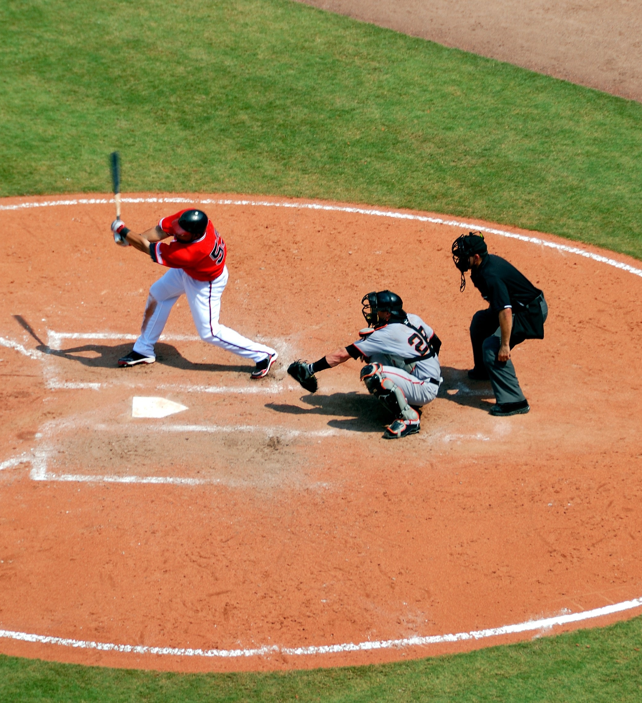
SQL for Data Science Capstone Project

Slide 2
PROJECT PROPOSAL
Laxmi Prabha Singh

Slide 3
STEP ONE
Preparing the Project Proposal

Slide 4
Selection of CLIENT
I would like to work with SportsStats which is a sports analysis firm partnering with local news and elite personal trainers to provide interesting insights to help their partners
Reason: I am a sports enthusiast and would love to see women’s representation in the Olympics

Slide 5
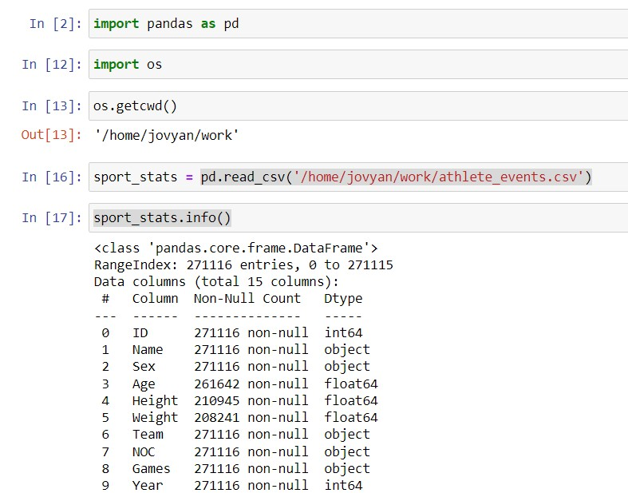
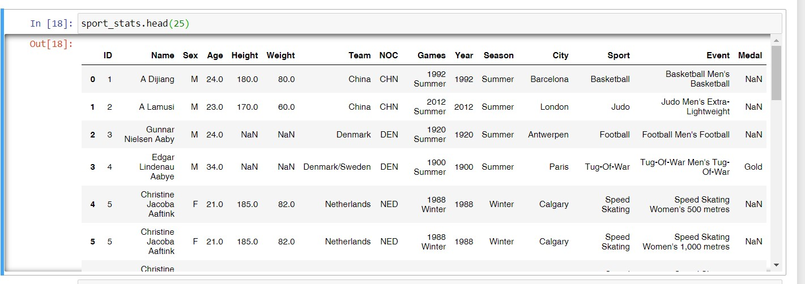
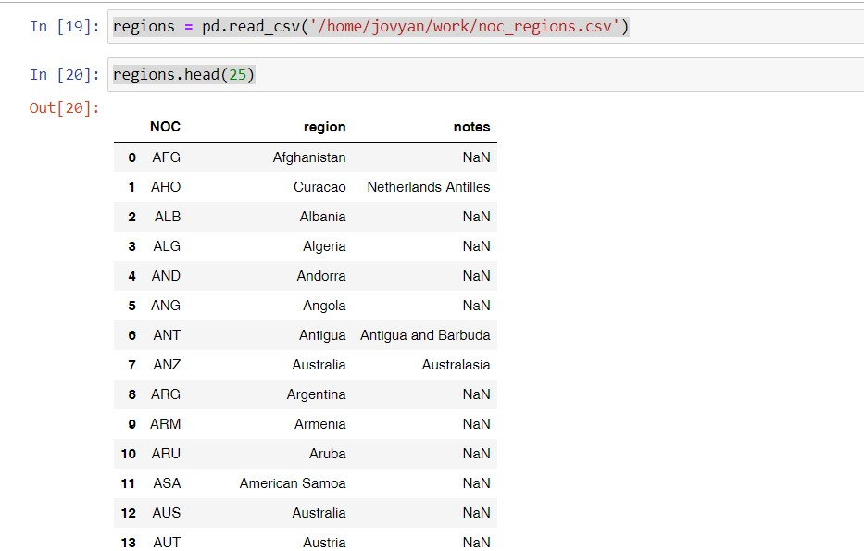
Steps for importing the data
Data Import
I imported the data from CSV file provided in the course.
For this, I first downloaded the zip file, extracted the CSV file, and uploaded it to my working directory for Jupyter.
From there, I started working on Jupyter and used Pandas to import and view my file

Slide 6
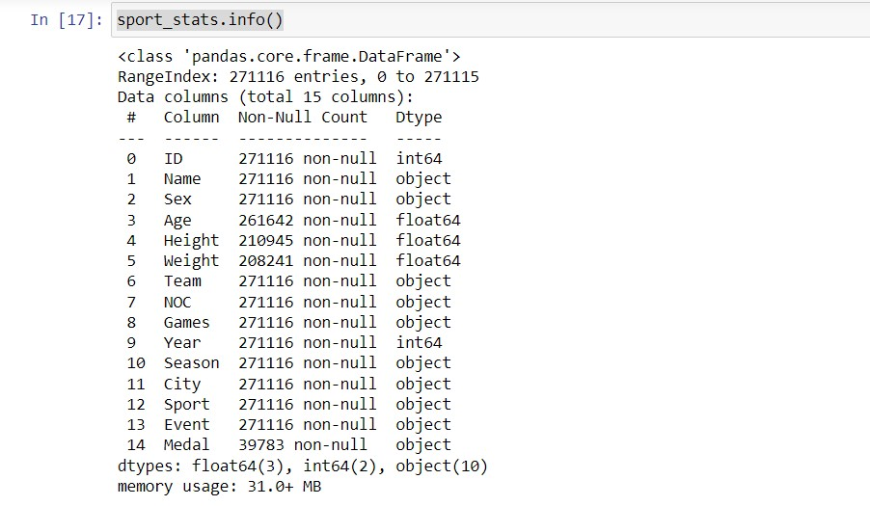
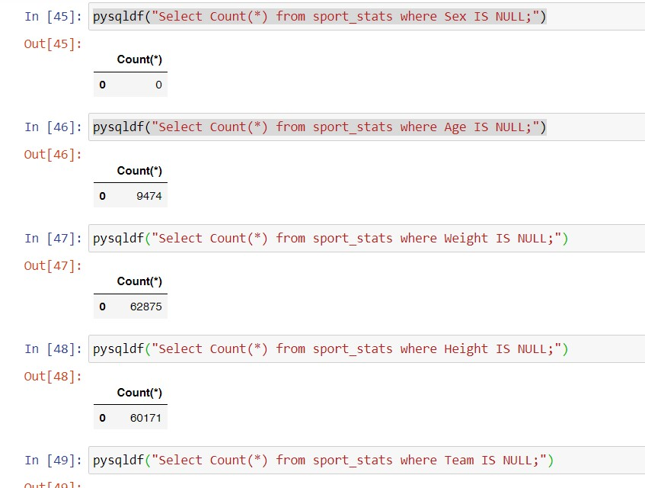
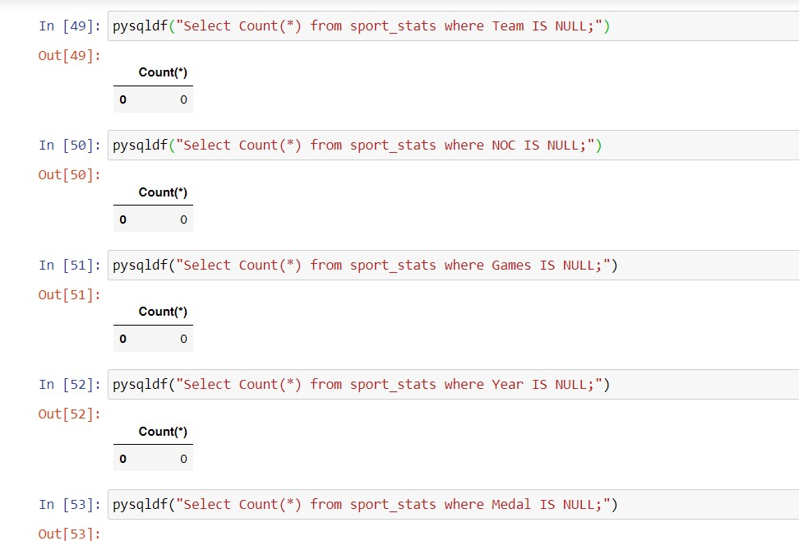
Steps for cleaning the data
Data cleaning
I first checked if all the columns have the correct data types
I checked for Null values.
I found that 9474 Age values, 62875 Weight values and 60171 Height values are NULL. The Medal column also has NaN values but that may not be missing data since not all participants won medals.
I did not do anything for the NULL values as I won’t be using them in my analysis.

Slide 7
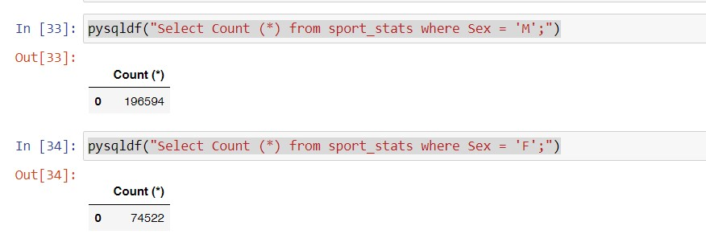
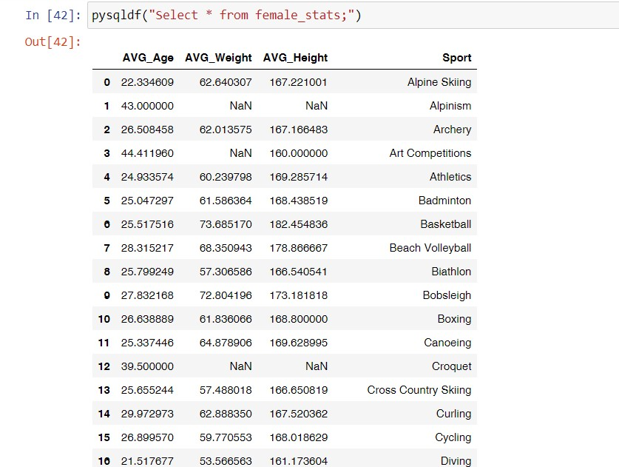
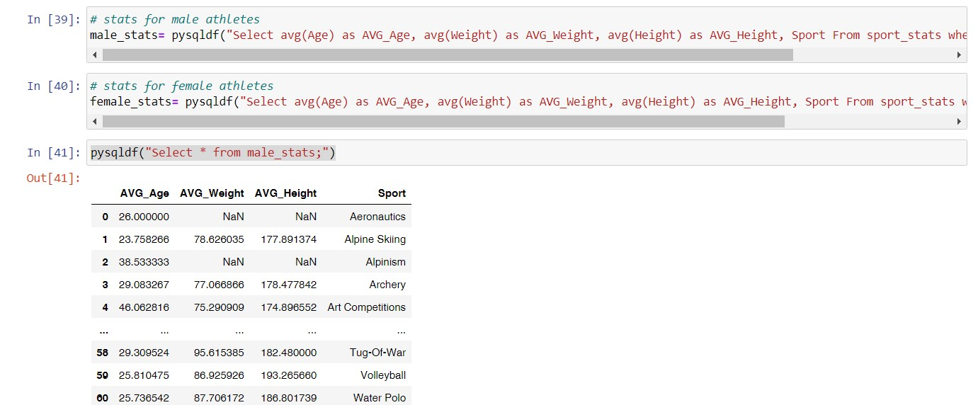
INITIAL EXPLORATION
I performed few initial explorations such as averages to get an understanding of the data. Calculated the averages for Male and Female

Slide 8
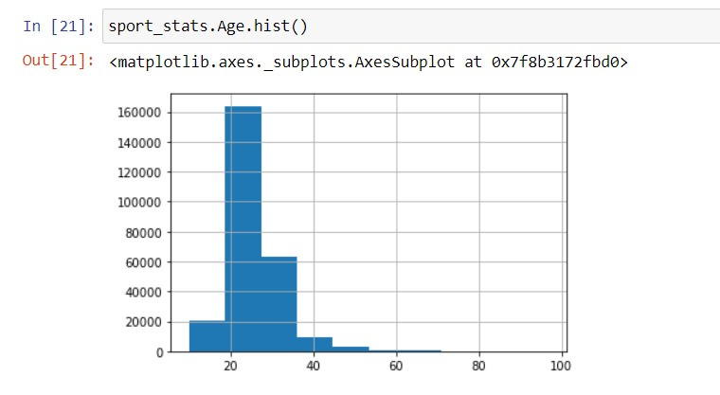
INITIAL EXPLORATION
I performed a few initial explorations such as averages to get an understanding of the data.
Calculated the averages for Male and Female

Slide 9
Questions?
Representation in Olympics
Age wise
Gender wise
Who performs better in the Olympics: Male or Female?
Top 5 performing countries in the Olympics
Top 3 Games where females are performing better than Males

Slide 10
Hypothesis
Representation in Olympics
Age wise: Higher numbers of athletes between 18-25 age group
Gender wise: More male athletes participate than females
Country wise: More Developed countries participate than developing countries
Who performs better in the Olympics: Male or Female?
Men
Top 5 performing countries in the Olympics
USA, China… (The countries with better resources (developed countries) have more prominent. Yes, there is a correlation between representation and winnings. The reasoning is as developed countries have more resources, they can provide better trainers, coaching, etc. hence more medals.)
Top 3 Games where females are performing better than Males
Which countries are more prominent in the Olympics and does representation correlate with winnings?

Slide 11
Proposed ERD
Sport_stats
Sports_id (Primary)
Athlete_id
Game_id
Event_id
Medal_id
Athlete_age
Athlete_sex
Athlete_height
Athlete_weight
Game_stats
Game_id (Primary)
Season_id
City_id
Year
Medals
Medal_id (Primary)
Medal_type
N
1
1
N
N
1
Athlete_stats
Athlete_id (Primary)
Region_id
Game_id
Athlete_name
Athlete_gender
Region_stats
Region_id (Primary)
City_id
Region_name
Country_name
M
N
1
N
Sports
Sports_id (Primary)
Season_id
Sport_name
N
1
Team_stats
Team_id (Primary)
Region_id
Team_name

Slide 12
Analysis

Slide 13
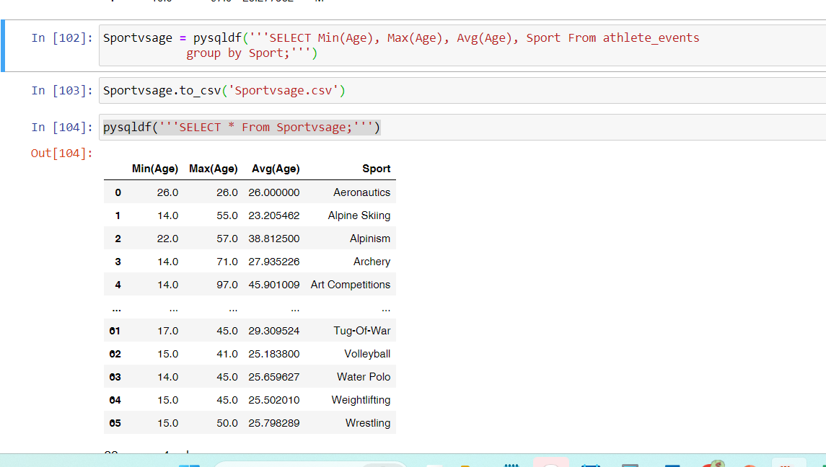
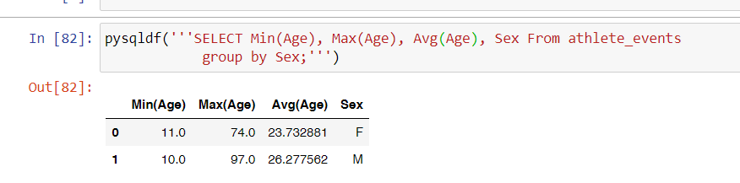
Representation in Olympics - Age
I wanted to see what is the average, minimum, and maximum age distribution for all the sports.

Slide 14
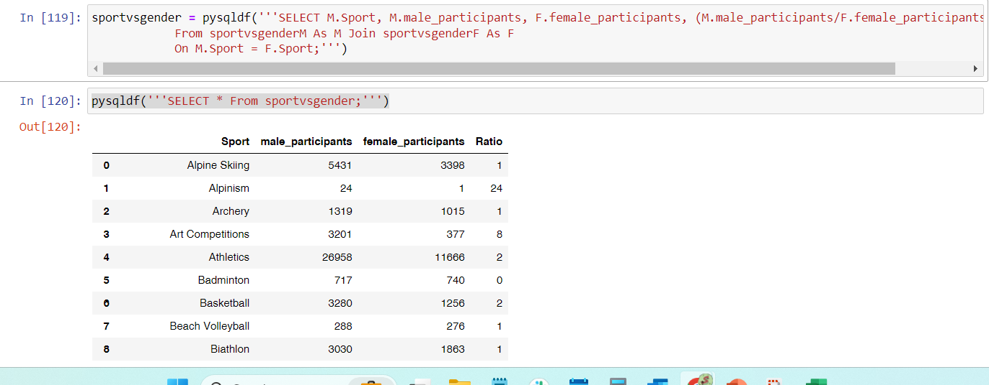
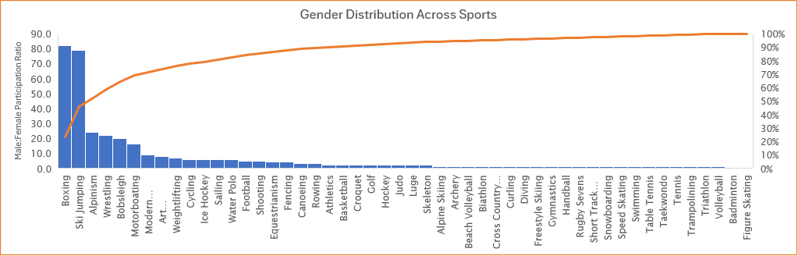
Representation in Olympics - Gender
I wanted to see what is the average, minimum, and maximum age distribution for all the sports.

Slide 15
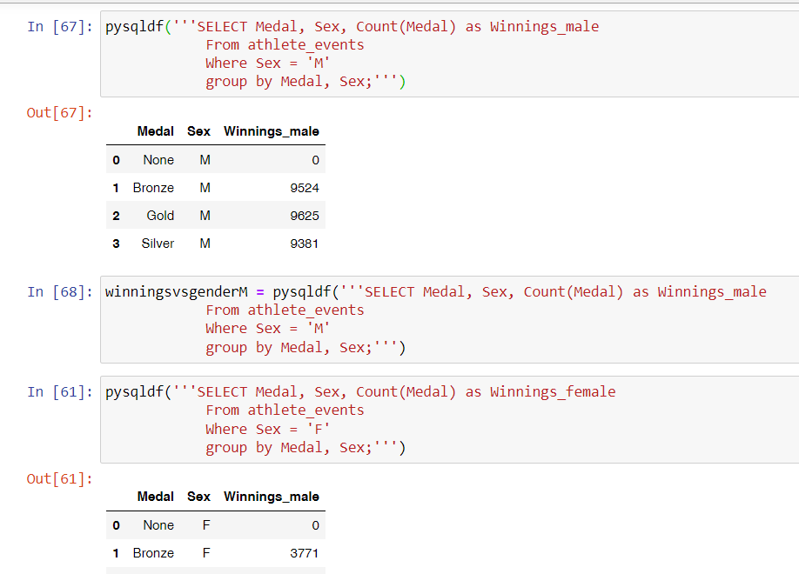
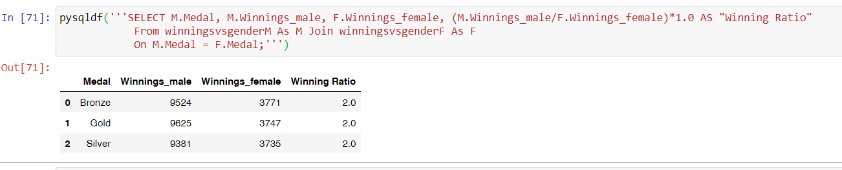
Who performs better in the Olympics: Male or Female?

Slide 16
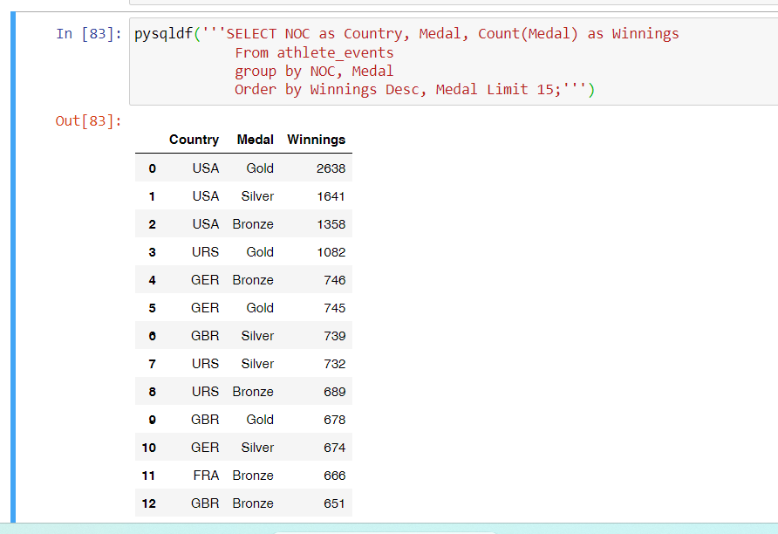
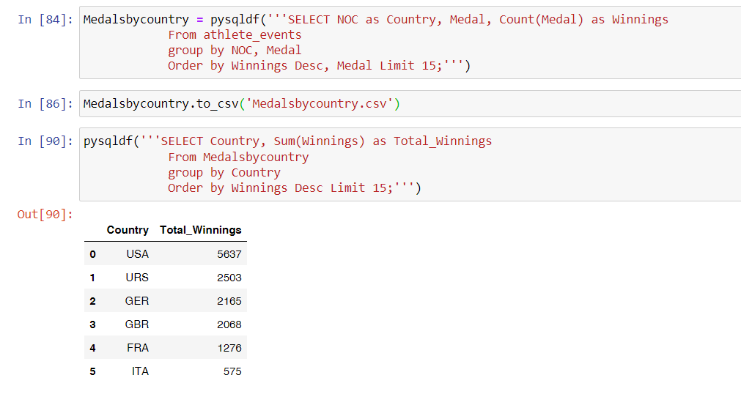
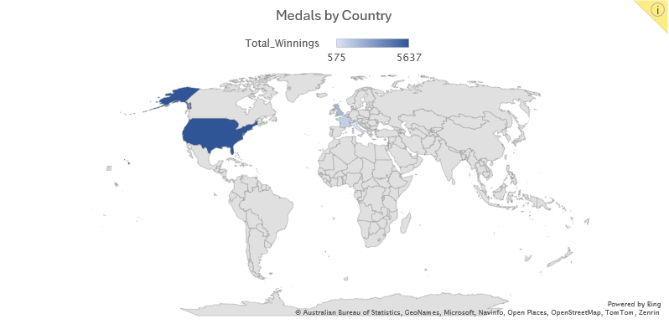
Top 5 performing countries in the Olympics
I wanted to see what is the average, minimum, and maximum age distribution for all the sports.

Slide 17
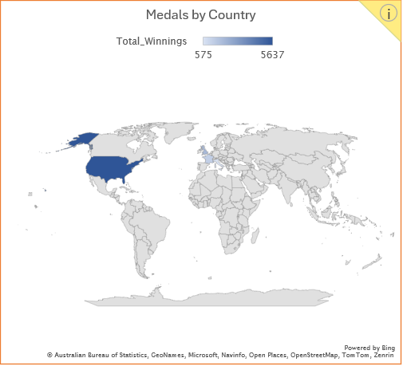
Top 5 performing countries in the Olympics
I wanted to see what is the average, minimum, and maximum age distribution for all the sports.

Slide 18
Top 3 Games where females are performing better than Males
I wanted to see what is the average, minimum, and maximum age distribution for all the sports.

Slide 19
Criteria Questions

Slide 20
Findings
Provide a summary of the different descriptive statistics
Age wise
I found that the average age of athletes participating in the Olympics is 20 for females and 26 for males
While the Minimum age for male athletes is 10, the Maximum age is 97 (Art Competition, I guess that doesn’t count and is an outlier)
For females, the minimum age was 11, and the maximum age was 74. Quite low from male athletes
Age also varies with the type of Sport
Gender wise
It was found that in most of the sports male representation is far higher than females. Boxing (84:1), Ski Jumping (79:1), Alpinism (24:1), Wrestling (22:1), Bobsleigh (20:!) to name the top 5.
Males have also won more medals than females (2X more!) but it is also because they participate more than women athletes
Top 5 performing countries in the Olympics - I found that the following were the top 5 performing countries:
USA, Russia, Germany, Guinea Bissau, France

Slide 21
Findings
Submit 2-3 key points you may have discovered about the data, e.g. new relationships? Aha's! Did you come up with additional ideas for other things to review?
I discovered that to find who is performing better, I need to provide relative winnings(Actual winning ratio = number of medals/number of males/females participating) for the genders as more male athletes are participating, the answer can be skewed if not considered properly
Did you prove or disprove any of your initial hypotheses? If so, which one and what do you plan to do next?
Yes, I was able to prove that the top-performing countries are the developed countries. Reasoning can be as they have better resources, coaches, etc.
What additional questions are you seeking to answer?
I want to dig deeper into understanding how female athletes are performing in comparison to their male counterparts

